Slide 1

AI IN BUSINESS WITH AWS SAGEMAKER AUTOPILOT: INSURANCE PREMUIM PREDICTION

Slide 2

AI APPLICATIONS IN BUSINESS
EASY
ADVANCED

Slide 3
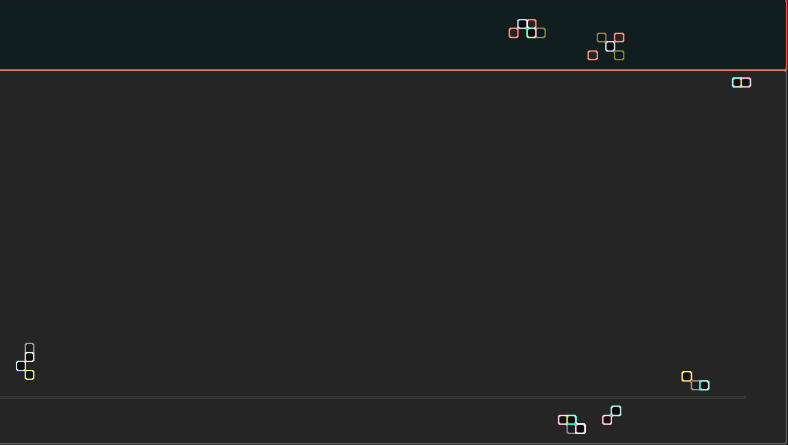
AI IN BUSINESS: WHAT PROBLEMS CAN AI SOLVE?
CLUSTERING-TYPE PROBLEMS: “WHICH GROUP OF MY CUSTOMERS SHOULD I TARGET FOR MY NEW MARKETING AD CAMPAIGN TO MAXIMIZE CONVERSION RATE?”
AI can help solve clustering-type problems that are crucial in performing marketing segmentation. Clustering works by trying to group customers based on their features.
RECOMMENDATION-TYPE PROBLEMS: “WHICH PRODUCT SHOULD I RECOMMEND TO MY CUSTOMERS TO MAXIMIZE REVENUE?”
AI can help solve recommendation-type problems by collaboratively studying customer historical behavioural data. These algorithms are called recommender systems, which you might notice while using such as Netflix or Amazon.
CLASSIFICATION-TYPE PROBLEMS: “ARE MY CUSTOMERS HAPPY OR NOT?”
As a data scientist, you can leverage data science to solve classification type problems. The answer to these problems can generally belong to two or more categories.
REGRESSION-TYPE PROBLEMS: “HOW MUCH SHOULD I PAY MY NEWLY HIRED EMPLOYEE?”
This is a regression-type problem where we attempt to predict a continuous output (salary) that does not necessarily belong to a group or category.
TIME-SERIES FORECASTING PROBLEMS: “HOW MUCH REVENUE WILL MY BUSINESS GENERATE NEXT MONTH?”
This is a time series forecasting problem in which we attempt to predict the future based on past historical data.

Slide 4

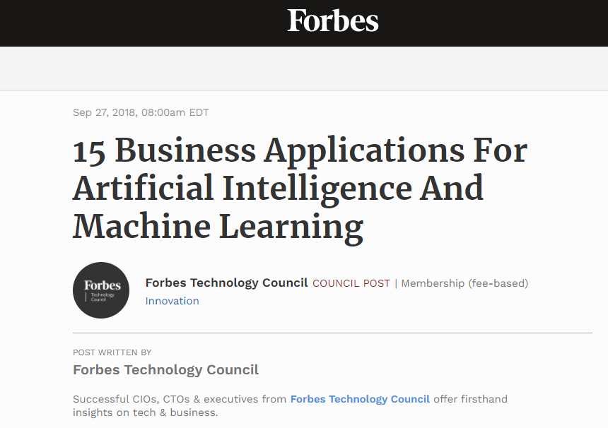

READING TIME & QUIZ: AI APPLICATIONS IN BUSINESS
Please read the article below and answer the following quiz.
Link to Article: https://www.forbes.com/sites/forbestechcouncil/2018/09/27/15-business-applications-for-artificial-intelligence-and-machine-learning/?sh=46e73b43579f
15 MINS
10 MINS

Slide 5
PROJECT OVERVIEW: INSURANCE PREMUIM PREDICTION
EASY
ADVANCED

Slide 6

PROJECT OVERVIEW & BUSINESS CASE
The objective of this case study is to predict the health insurance cost incurred by Individuals based on their age, gender, BMI, number of children, smoking habit and geo-location.
Image source: https://www.publicdomainpictures.net/en/view-image.php?image=279909&picture=medical-insurance

Slide 7
PROJECT OVERVIEW AND BUSINESS CASE
The available features are:
sex: insurance contractor gender
bmi: Body mass index (ideally 18.5 to 24.9)
children: Number of children covered by health insurance / Number of dependents
smoker: Smoking
region: the beneficiary's residential area in the US, northeast, southeast, southwest, northwest.
Target (output):
charges: Individual medical costs billed by health insurance
Data Source: https://www.kaggle.com/mirichoi0218/insurance

Slide 8
MINI CHALLENGE
Read this article by McKinsey & Company and answer the following questions: https://www.mckinsey.com/business-functions/mckinsey-analytics/our-insights/the-executives-ai-playbook?page=industries/
How much value does McKinsey & Company predict AI could potentially bring across all industries?
What about the “insurance” industry?
What about “risk modeling” domain?
State the difference between traditional AI and Advanced AI in the article’s context.

Slide 9
MINI CHALLENGE SOLUTION
Read this article by McKinsey & Company and answer the following questions: https://www.mckinsey.com/business-functions/mckinsey-analytics/our-insights/the-executives-ai-playbook?page=industries/
How much value does McKinsey & Company predict AI could potentially bring across all industries? $9.5T - $15.4T
What about the “insurance” industry? $1.1T
What about “risk modeling” domain? $32.0B
State the difference between traditional AI and Advanced AI in the article’s context. Traditional AI indicates basic machine learning and statistical techniques while advanced AI indicates deep learning and artificial neural networks.

Slide 10
SIMPLE AND MULTIPLE LINEAR REGRESSION, SIMPLIFIED!
EASY
ADVANCED

Slide 11

SIMPLE LINEAR REGRESSION
Goal is to obtain a relationship (model) between two variables only such as age and insurance cost for example.
MODEL! (GOAL)
$$y=b+m∗x$$
INSURANCE COST ($)
DEPENDANT VARIABLE
INSURANCE PREMIUM ($)
INDEPENDENT VARIABLE
AGE (YEARS)
AGE (YEARS)

Slide 12
MULTIPLE LINEAR REGRESSION
Multiple Linear Regression: examines relationship between more than two variables.
Recall that Simple Linear regression is a statistical model that examines linear relationship between two variables only.
Each independent variable has its own corresponding coefficient.
$$y=b_{0}+b_{1}∗x_{1}+b_{2}∗x_{2}+..+b_{n}x_{n}$$
DEPENDANT VARIABLES
INSURANCE COST ($)
INDEPENDENT VARIABLES
(AGE, SMOKING HABITS, REGION,..ETC)

Slide 13
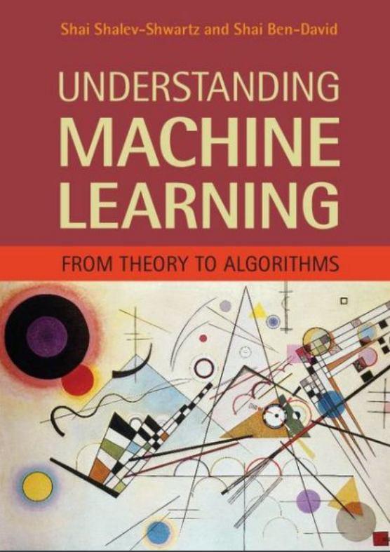
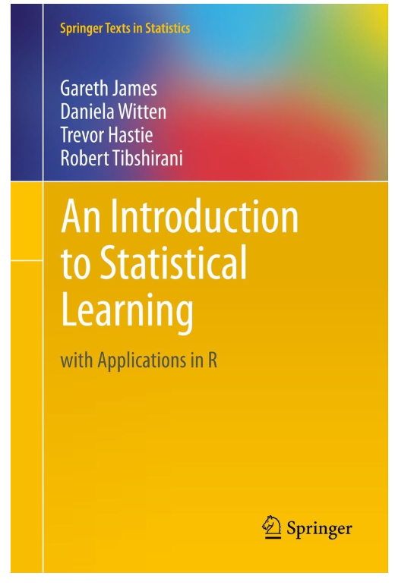
SIMPLE LINEAR REGRESSION: ADDITIONAL READING MATERIAL
Additional Resources, Page #123: http://www.cs.huji.ac.il/~shais/UnderstandingMachineLearning/understanding-machine-learning-theory-algorithms.pdf
Additional Resources, Page #61:
http://www-bcf.usc.edu/~gareth/ISL/ISLR%20Seventh%20Printing.pdf

Slide 14






MINI CHALLENGE:
Match the equations to the figures below and explain why:
$$y=4∗x$$
$$y=20−5∗x$$
$$y$$
$$y$$
$$x$$
$$x$$

Slide 15
AMAZON WEB SERVICES (AWS) 101 & DEMO
EASY
ADVANCED

Slide 16

AWS 101
Compute
Storage
Databases
Networking
Analytics
Machine learning & Artificial intelligence (AI)
Internet of Things (IoT)
Amazon Web Services (AWS) is the world’s top cloud platform.
AWS offers more than 165 fully featured services (40 of them are not offered anywhere else!).
AWS is adopted by millions of customers globally including small- and large-scale enterprises.
AWS enables companies to be more agile, flexible, secure at a fraction of the cost.
AWS provides services for broad range of applications as shown on the chart.
Photo Credit: https://commons.wikimedia.org/wiki/File:AmazonWebservices_Logo.svg

Slide 17
RECALL WHAT ARE THE 3 KEY AI/ML COMPONENTS?
1. DATA
2. MODEL
3. COMPUTE

Slide 18
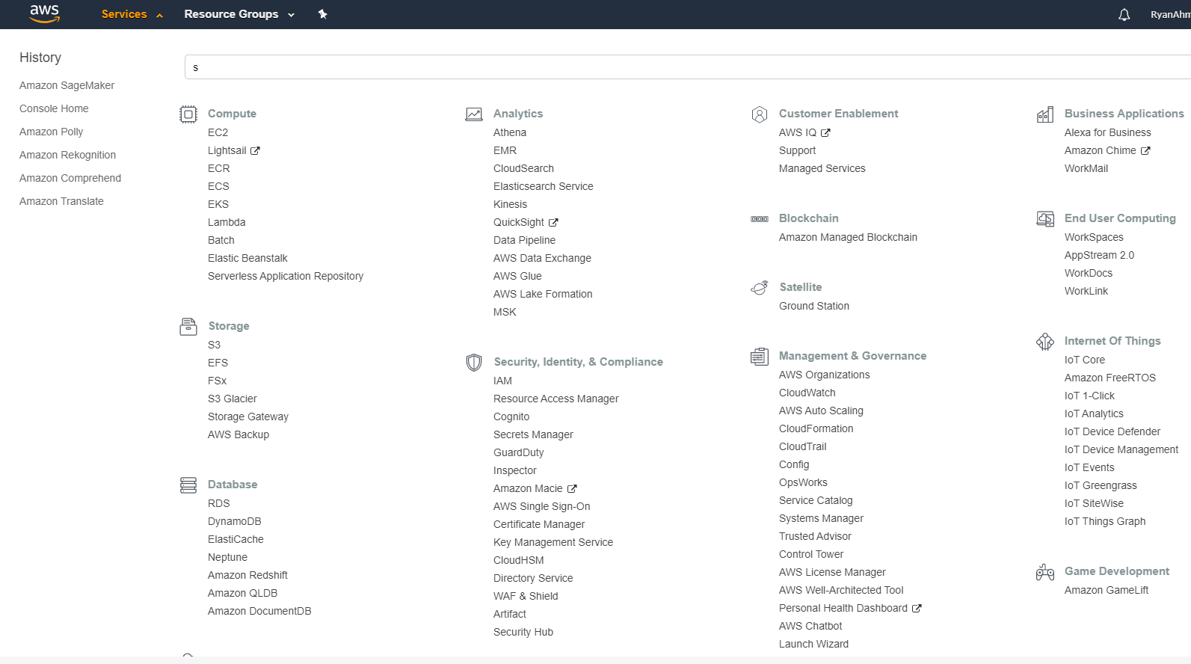
AWS TOUR!
LET’S GO ON AN AWS TOUR!

Slide 19
AWS SERVICES: STORAGE AND COMPUTE
3
1

Slide 20
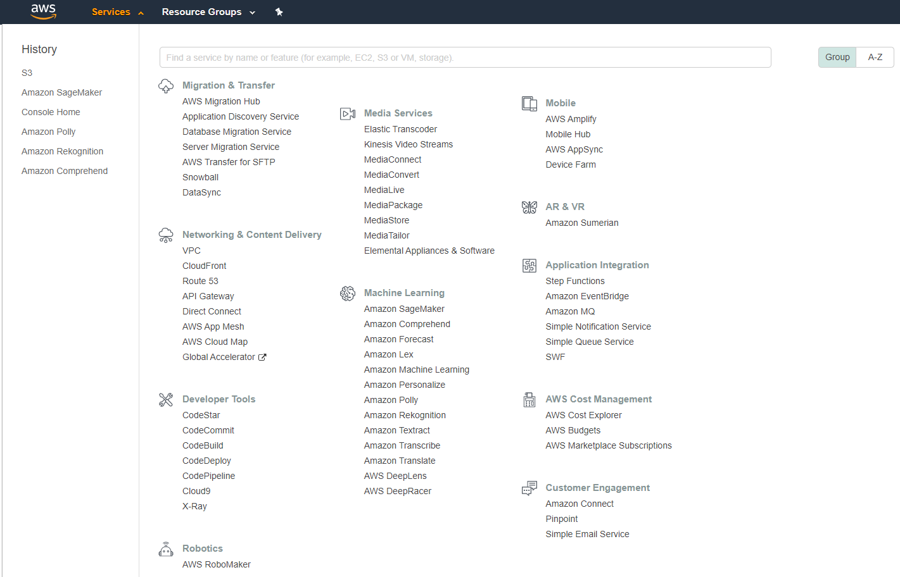
AWS SERVICES: MACHINE LEARNING
2

Slide 21
AWS S3 (STORAGE) & EC2 (COMPUTE)
EASY
ADVANCED

Slide 22


WHAT IS AMAZON S3 (STORAGE)?
Amazon Simple Storage Service (Amazon S3) is a storage service that allows enterprises/individuals to store and protect any amount of data.
Amazon S3 offers numerous enhanced features such as:
(1) Scalability
(2) Data availability
(3) Security
(4) Performance
Amazon S3 is extremely easy to use and allows enterprises to organize their data and configure finely-tuned access controls.
Amazon S3 allows customers to store data in buckets or directories (much like folders). Each of the buckets will have global (universal) unique name.
Amazon S3 extremely durable to 99.999999999% (11 9’s).
Amazon S3 is 99.9% available.
Photo Credit: https://commons.wikimedia.org/wiki/File:AWS_Simple_Icons_AWS_Cloud.svg
Photo Credit: https://commons.wikimedia.org/wiki/File:AWS_Simple_Icons_Storage_Amazon_S3.svg

Slide 23
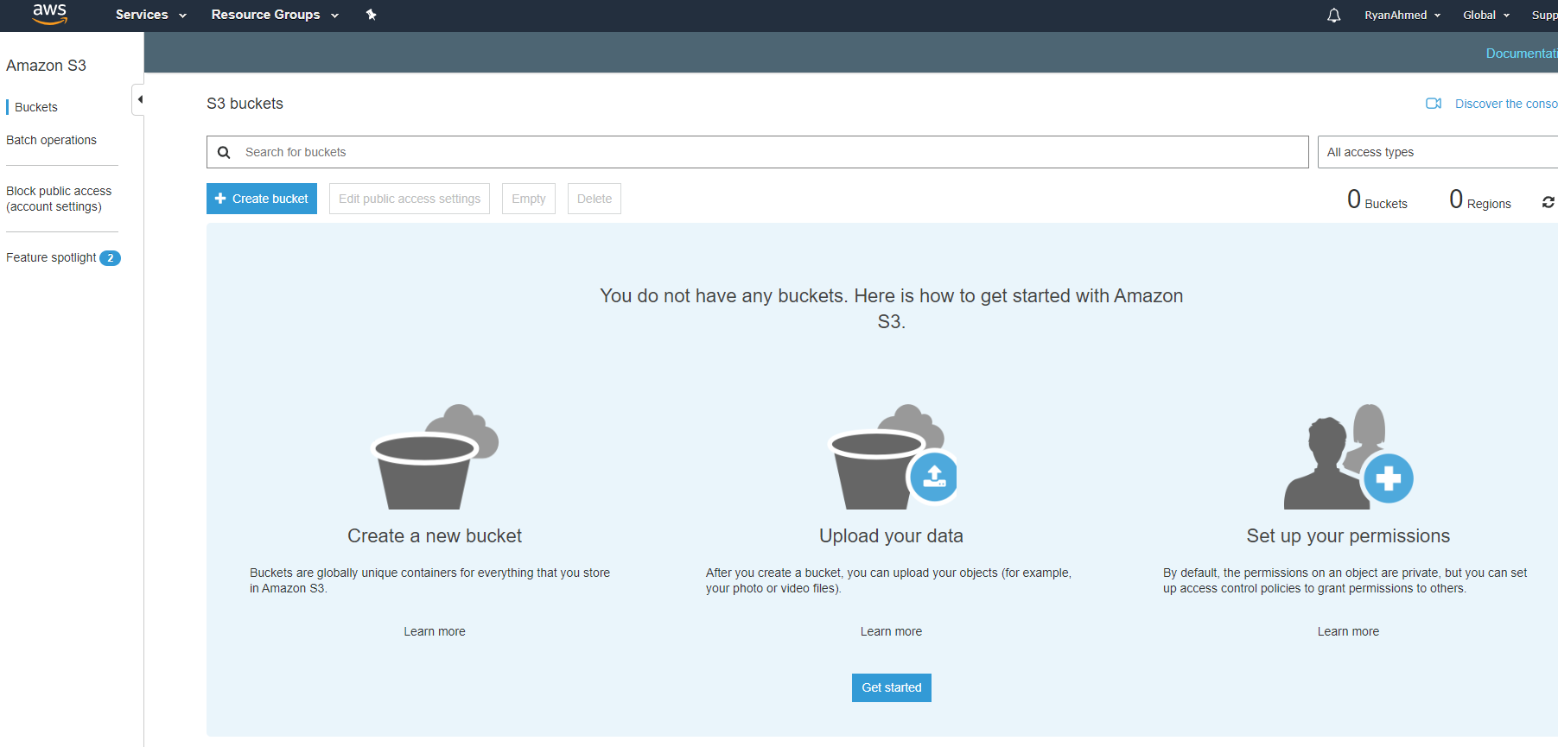
WHAT IS AMAZON S3 (STORAGE)?
CREATE A BUCKET AND SIMPLY UPLOAD DATA TO IT

Slide 24


WHAT IS AMAZON EC2 (COMPUTE)?
Amazon Elastic Compute Cloud (Amazon EC2) offers resizable compute capacity in the cloud.
AWS EC2 can be used to acquire, configure and scale capacity in a very easy fashion.
EC2 is a service that allows you to simply rent a server in the cloud.
EC2 covers 22 regions and 69 availability zones all over the world.
AMAZON EC2
Photo Credit: https://pixabay.com/photos/transistors-gpu-processor-pc-chip-1137502/

Slide 25
AMAZON SAGEMAKER 101
EASY
ADVANCED

Slide 26
AMAZON SAGEMAKER
Amazon SageMaker is a fully-managed machine learning workflow platform that provides services on data labeling, model building, training, tuning and deployment.
SageMaker allows data scientists and developers to build scalable AI/ML models easily and efficiently.
Models could be deployed in production at a much faster rate and with a fraction of the cost.
Let’s explore SageMaker: https://aws.amazon.com/sagemaker/#
BUILD
SageMaker offers data labeling service
TRAIN
Manage environments for training
DEPLOY
Prebuilt available notebooks with state-of-the-art algorithms on AWS marketplace
Hyperparameters optimization for model tuning
Train models using EC2 instances (on-demand and spot)
Easily deploy and scale models
Autoscaling with 75% savings

Slide 27


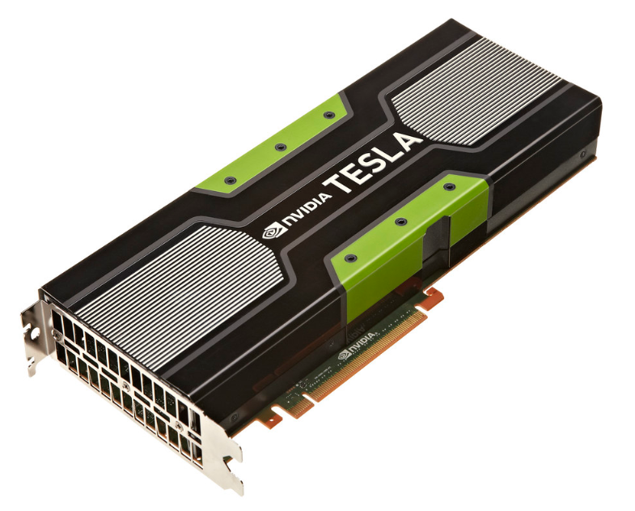
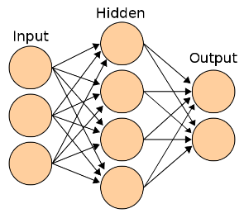
AMAZON SAGEMAKER MODEL TRAINING AND DEPLOYMENT OVERVIEW
Source: https://docs.aws.amazon.com/sagemaker/latest/dg/how-it-works-training.html
https://commons.wikimedia.org/wiki/File:Artificial_neural_network.svg
https://commons.wikimedia.org/wiki/File:AWS_Simple_Icons_Storage_Amazon_S3.svg
https://docs.aws.amazon.com/sagemaker/latest/dg/how-it-works-training.html
https://www.flickr.com/photos/gbpublic/8178512552
CLIENT
END POINT
Inference code image
S3 BUCKET
MODEL ARTIFACTS
MODEL DEPLYMENT/HOSTING
On ML Compute instances
Training code image
MODEL TRAINING
On ML Compute instances
S3 BUCKET
TRAINING BUCKET
EC2 CONTAINER REGISTERY
AMAZON SAGEMAKER

Slide 28
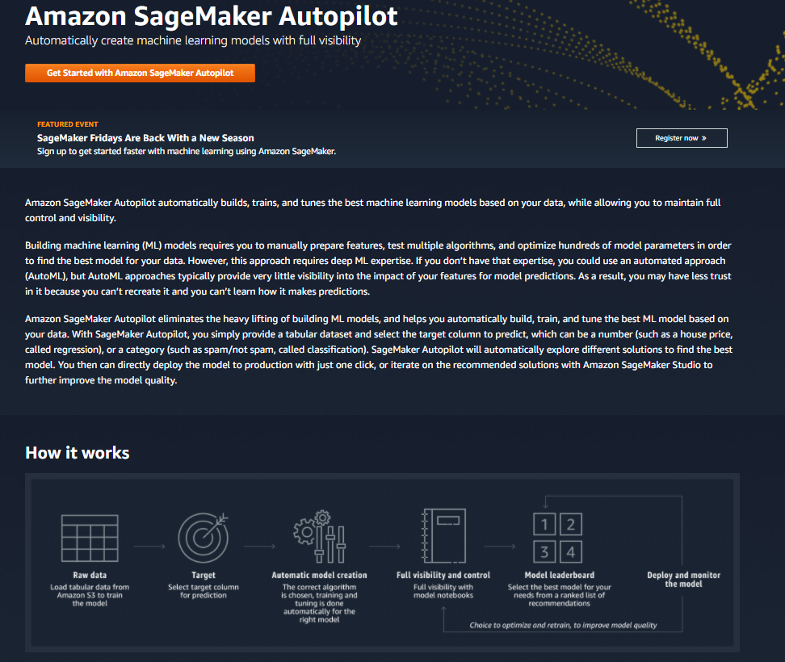
AMAZON SAGEMAKER AUTOPILOT 101
Check this out: https://aws.amazon.com/sagemaker/autopilot/

Slide 29
REGRESSION METRICS
EASY
ADVANCED

Slide 30



REGRESSION METRICS: HOW TO ASSESS MODEL PERFORMANCE?
After model fitting, we would like to assess the performance of the model by comparing model predictions to actual (True) data
$y_{i}$ (actual)
$$Error$$
$$Residuals (Error)={\hat{y}}_{i}−y_{i}$$
INSURANCE COST ($)
${\hat{y}}_{i}$(estimated/predicted)
AGE (YEARS)

Slide 31

REGRESSION METRICS: MEAN ABSOLUTE ERROR (MAE)
Mean Absolute Error (MAE) is obtained by calculating the absolute difference between the model predictions and the true (actual) values
MAE is a measure of the average magnitude of error generated by the regression model
The mean absolute error (MAE) is calculated as follows:
$$MAE=\frac{1}{n}\sum_{i=1}^{n}{|y_{i}−{\hat{y}}_{i}|}$$
MAE is calculated by following these steps:
Calculate the residual of every data point
Calculate the absolute value (to get rid of the sign)
Calculate the average of all residuals
If MAE is zero, this indicates that the model predictions are perfect.

Slide 32

REGRESSION METRICS: MEAN SQUARE ERROR (MSE)
Mean Square Error (MSE) is very similar to the Mean Absolute Error (MAE) but instead of using absolute values, squares of the difference between the model predictions and the training dataset (true values) is being calculated.
MSE values are generally larger compared to the MAE since the residuals are being squared.
In case of data outliers, MSE will become much larger compared to MAE
In MSE, error increases in a quadratic fashion while the error increases in proportional fashion in MAE
In MSE, since the error is being squared, any predicting error is being heavily penalized
The MSE is calculated as follows:
$$MSE=\frac{1}{n}\sum_{i=1}^{n}{{\left(y_{i}−{\hat{y}}_{i}\right)}^{2}}$$
MSE is calculated by following these steps:
Calculate the residual for every data point
Calculate the squared value of the residuals
Calculate the average of results from step #2

Slide 33

REGRESSION METRICS: ROOT MEAN SQUARE ERROR (RMSE)
Root Mean Square Error (RMSE) represents the standard deviation of the residuals (i.e.: differences between the model predictions and the true values (training data)).
RMSE can be easily interpreted compared to MSE because RMSE units match the units of the output.
RMSE provides an estimate of how large the residuals are being dispersed.
The RMSE is calculated as follows:
$$RMSE=\sqrt{\frac{1}{n}\sum_{i=1}^{n}{{\left(y_{i}−{\hat{y}}_{i}\right)}^{2}}}$$
RMSE is calculated by following these steps:
Calculate the residual for every data point
Calculate the squared value of the residuals
Calculate the average of the squared residuals
Obtain the square root of the result

Slide 34


REGRESSION METRICS: R SQUARE ($R^{2}$)-COEFFICIENT OF DETERMINATION
R-square or the coefficient of determination represents the proportion of variance (of y) that has been explained by the independent variables in the model.
If $R^{2}=80$, this means that 80% of the increase in insurance cost is due to increase in the age of the applicant.
INSURANCE COST
AGE

Slide 35


REGRESSION METRICS: R SQUARE ($R^{2}$)-COEFFICIENT OF DETERMINATION
R-square represents the proportion of variance of the dependant variable (y) that has been explained by the independent variables.
R-square provides an insight of goodness of fit.
It gives a measure of how well unseen samples are likely to be predicted by the model, through the proportion of explained variance.
Maximum $R^{2}$ value is 1
A constant model that always predicts the expected value of y, disregarding the input features, will have an R² score of 0.0.
$$R^{2}=1−\frac{\sum_{i=1}^{n}{{\left(y_{i}−{\hat{y}}_{i}\right)}^{2}}}{\sum_{i=1}^{n}{{\left(y_{i}−\overline{y}\right)}^{2}}}$$

Slide 36
AWS SAGEMAKER AUTOPILOT DEMO
EASY
ADVANCED

Slide 37
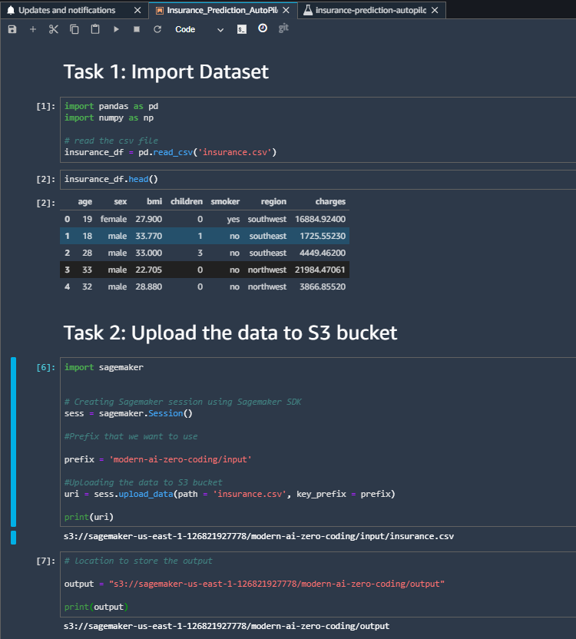
AMAZON SAGEMAKER AUTOPILOT
RUN THIS SCRIPT

Slide 38
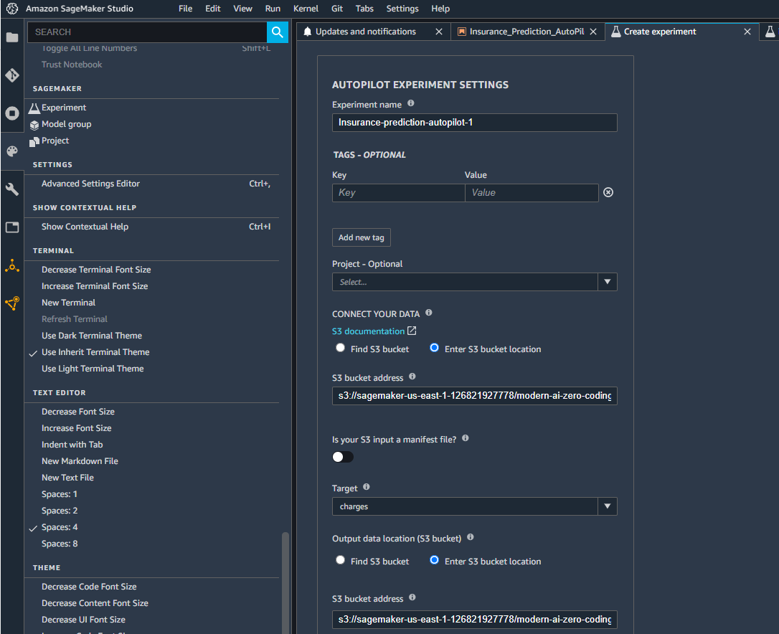
AMAZON SAGEMAKER AUTOPILOT
Check this out: https://aws.amazon.com/sagemaker/autopilot/
1. CLICK ON EXPERIMENT
2. PROVIDE A NAME FOR THE EXPERIMENT

Slide 39
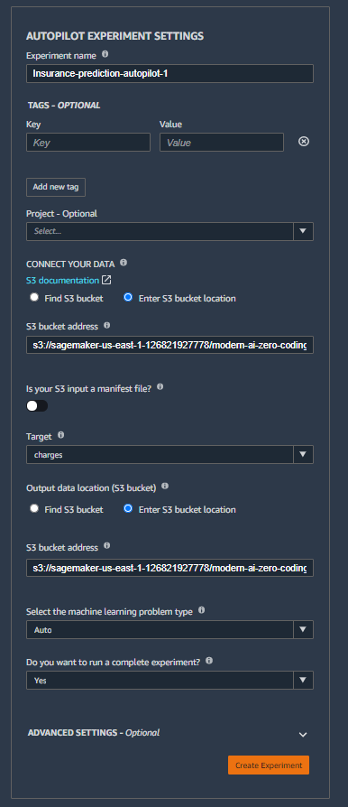
AMAZON SAGEMAKER AUTOPILOT
SELECT ”ENTER S3 BUCKET LOCATION”
PROVIDE THE LOCATION OF TRAIN DATA IN S3 (CAN BE FOUND IN .IPYNB NOTEBOOK)
PROVIDE THE COLUMN NAME OF TARGET VARIABLE
SELECT “ENTER S3 BUCKET LOCATION”
PROVIDE THE PATH TO STORE THE OUTPUT IN S3 (CAN BE FOUND IN .IPYNB NOTEBOOK)
CLICK CREATE EXPERIMENT

Slide 40
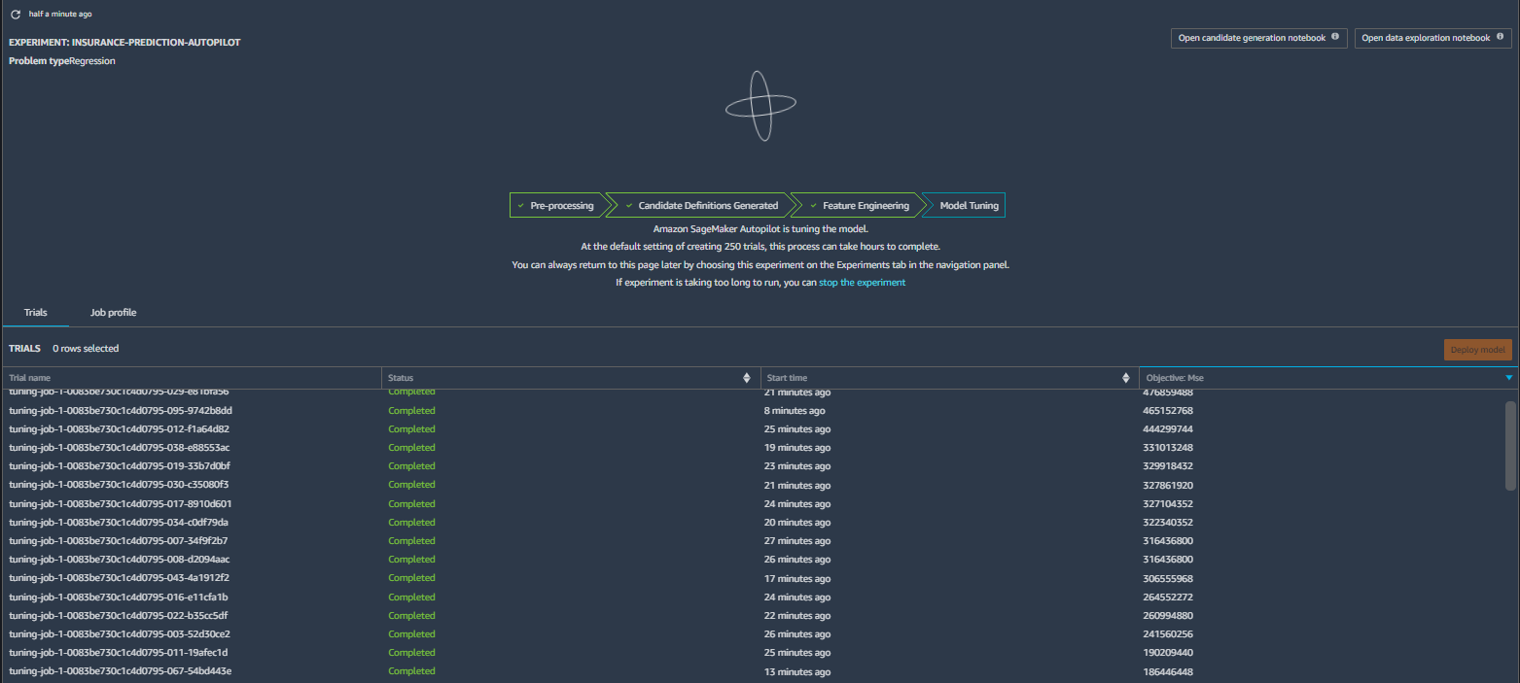
AMAZON SAGEMAKER AUTOPILOT
AFTER CREATING EXPERIMENT, YOU SHOULD SEE SOMETHING LIKE THIS.
IT WOULD TAKE AROUND 2 HOURS TO COMPLETE. THIS IS BECAUSE BY-DEFAULT IT WOULD RUN 250 TUNING JOBS TO FIGURE-OUT THE BEST HYPER-PARAMETER

Slide 41
AMAZON SAGEMAKER AUTOPILOT
Once first 2 steps are completed, you can view candidate generation notebook and data exploration notebook.
CLICK ON THESE TO OPEN RESPECTIVE NOTEBOOKS.
NOTE: GENERATED NOTEBOOKS FROM OUR EXPERIMENT ARE PROVIDED FOR REFERENCE.

Slide 42
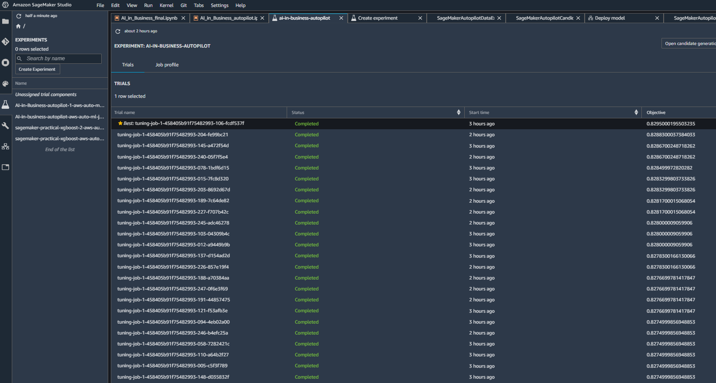
AMAZON SAGEMAKER AUTOPILOT
ONCE THE JOB IS COMPLETED, YOU CAN SELECT THE BEST MODEL AND THEN CLICK ON DEPLOY MODEL TO DEPLOY.

Slide 43
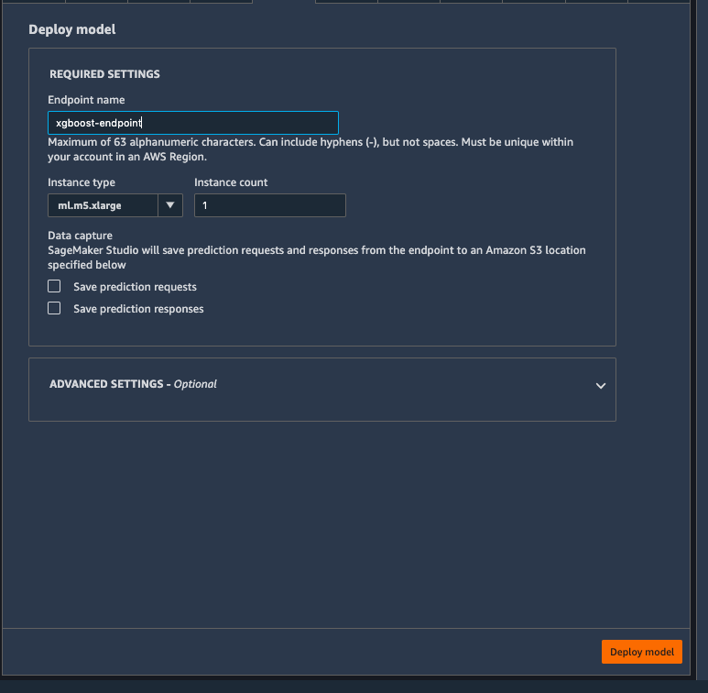
AMAZON SAGEMAKER AUTOPILOT
PROVIDE THE NAME FOR END-POINT
SELECT THE INSTANCE TYPE AND THE NUMBER OF INSTANCE
CLICK TO DEPLOY THE MODEL

Slide 44
DELETE ENDPOINT [IMPORTANT]
EASY
ADVANCED

Slide 45
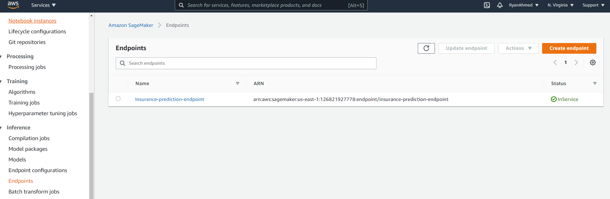
DELETE ENDPOINT [IMPORTANT]
SELECT ENDPOINT
CLICK ACTION AND DELETE THE ENDPOINT

